Slide 1


DataCo Online Sales Analysis
Data Visualization
Presented By -
KRISHNA AGRAWAL

Slide 2
TABLE OF CONTENTS
01
Subject + Dataset
02
Audience + Context
03
Data Analysis
04
Visual Creation
05
Dashboard Mockup

Slide 3
01
Subject & Dataset
Subject: Online Sales Data
The dataset chosen contains online sales data from DataCo Global.
The company is an online store, selling products across the main categories of clothing, sports, and electronic supplies.
They have international operations, receiving and delivering orders in 5 main markets: Africa , Europe , LATAM , Pacific Asia , USCA.
The dataset can be found here.
Dataset: Description & Data Cleaning/Transformation
The dataset contains 180,519 rows across 52 fields.
Main dimensions for fields can be grouped by: Sales Numbers, Order Information (Delivery Time, Geography), Customer Information, , Product Information.
Data types include: Text, Date, Numeric, Currency, Boolean.
Data cleaning on countries field (erroneous naming for MAC users).
Data transformation to create column with the days difference between real delivery time - scheduled delivery time → This allows insight about the distribution of how many days orders were early/late.

Slide 4
02
Audience & Context
Who/Main Stakeholders:
Sales Director
Marketing Team
Customer Service Team
Data & Analytics Team
Legal Department
What/Challenge:
Global market is growing dynamically with differences across regions/markets
The Sales director wants to have clear tracking of sales and insights regarding the different regions. The current practice of reporting is not goal-oriented:
Regional managers report their sales numbers on the phone on an adhoc basis (problem of transparency & trustworthiness)
Quarterly Reports are messy and badly organized (Different excel files across different regions and relevant dimensions like sales, customer info, product, etc. → lack of consistency and easy interpretability of data)
Where:
The problem of intransparent and confusing data presentation affects teams globally making it hard to make data-driven decisions
Implementing an online dashboard will make the required information accessible to everyone independent from their location

Slide 5
02
Audience & Context
Why? → There are several issues the company is facing:
Increasing market pressures make the optimization of sales processes imperative underlining the need for clear overview to react in a data driven manner across different business dimensions (i.e. geographies, promotion campaigns, customer engagement, popular products/segments, etc.).
The company has been facing plummeting customer satisfaction levels due to continuous high rates of late deliveries (>50%). This is seen as one of the reasons for some customers canceling their orders (approx. 4% cancelation rate). This is clearly hurting the company’s bottom line and reputation.
Past data indicates that fraud has had a negative impact on the business. Having a clear picture of this indicator will be helpful to take quick action and implement preventative measures in the future.
When / How?
The company has global operations, so it is necessary to provide a functioning dashboard with all relevant information while assuring data integrity on a 24/7 basis for all users.

Slide 6

03
Data Analysis
3.1 MECE Logic Tree
3.2 Storyboard Methodology
3.3 Explanation Goal-Driven KPIs

Slide 7
MECE Approach
3.1
By next year, we want to increase our revenue by 10%
Increase Sales
Decrease Costs
Identify emerging/decreasing markets
Identify low selling product
Reduce delivery issues
Reduce frauds
Having a more equal distribution across different markets
Marketing promotion
Improve
Product
Counter the lack of resources
Optimize the inventory on specific product
Identify existing frauders
Identify method of frauding
Take legal actions
Prevent for future frauds
Notes:
Areas of important registered activities: Provisioning, Production, Sales, Commercial Distribution

Slide 8
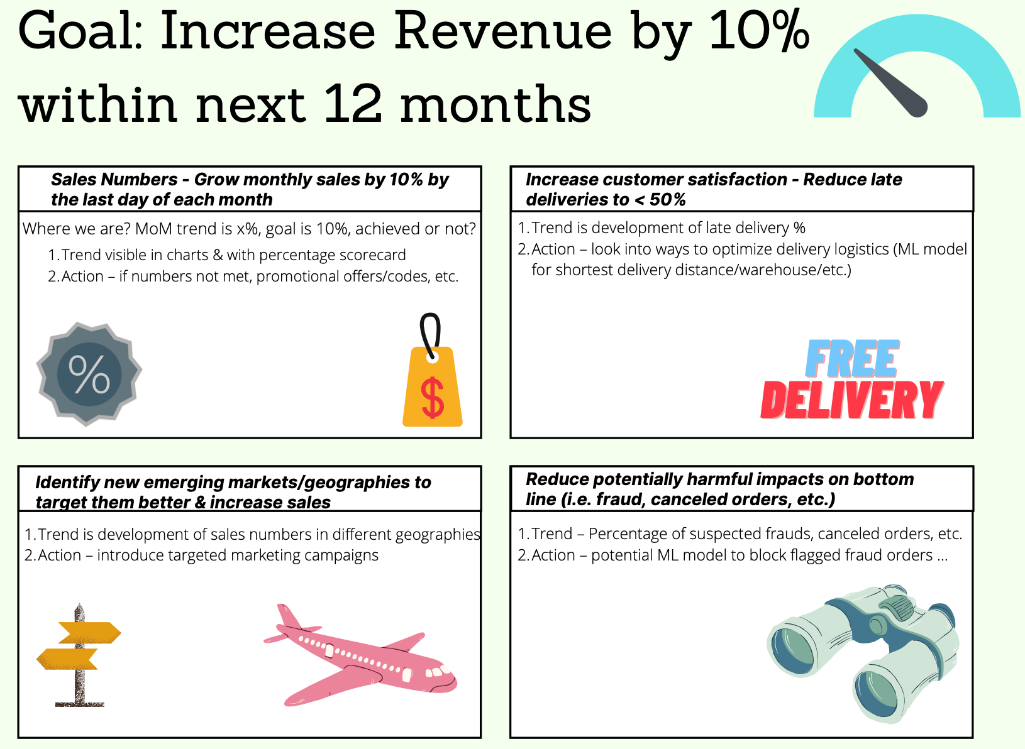
3.2
Storyboard Methodology
Notes:
Areas of important registered activities: Provisioning, Production, Sales, Commercial Distribution

Slide 9
3.3
Goal-Driven KPIs - 1
KPI 1: Increase Sales – Grow monthly sales by 10% per month YoY:
Based on our analysis, the total sales recorded till date is 36.78 million dollars with 20.66 dollar average discount and profit of 3.97M dollar (11% of total sales). In order to increase sales by 10% compare to last year, we need to identify products that are low performing or causing losses, either by launching promotions/marketing campaigns or improving the product itself.
Collecting information on category/product level will help us establish benchmark on our sales across global market. From the visual dashboard, we can clearly get the insights on sales trend over months in different years to drill down our analysis on the demand of the specific category/product in that time frame to better understand the need of the customer. Additionally, we can narrow down our analysis on the categories/products that are at loss in the specific region to further our analysis.
KPI 2: Increase customer satisfaction – Reduce late deliveries to <= 50% of total deliveries:
Due to high rates of late deliveries in the years 2015-2018 (>54% p.a.) the company has been facing decreasing levels of customer satisfaction. This is partly responsible for canceled orders being above 4% of total orders every year, clearly impacting the profit bottom line of the company. Reducing late deliveries aims to not only increase customer satisfaction but also to directly profit the company. Being able to narrow down on different time dimensions (years, months, days) can give insights about overall trends and seasonality. This coupled with other filters for: delivery status, shipping mode, product name, customer segment, order region will create a powerful dashboard for decision-makers.

Slide 10
3.3
Goal-Driven KPIs - 2
KPI 3: Identify new emerging markets/geographies to target them better & increase sales:
Our total sales around the world for our date range (2015-2018) is 36.78 million dollars with the average order dollar volume of 203.77 dollars. Collecting information on country statistics allows us to establish benchmarks across regional markets and perform better targeting.
By analyzing where sales are already well performing and where we could try to target new customer segments, we want to increase our total revenue. Our customers are not proportionally distributed between continents, for example Europe gives us a way higher turnover than Asia. So, we want to target more Asia and Canada in the future and come up with marketing and promotions campaigns to boost sales.
KPI 4: Reduce potentially harmful impacts on bottom line (i.e. fraud, canceled orders, etc.):
With a total loss sales of 3.9 millions, it’s important to reduce the harmful impact. This is mainly due to canceled orders but also suspected frauds as it represents around 15% of total losses. On closer inspection, we can observe some suspected frauds are repeated on some products by the same customers. With a 100% suspected frauds made with wire transfer, it is, therefore, important to identify how they are proceeding and estimate the amount of the damage in order to take legal action.
Also a potential action to take can be to introduce ML models to identify and block potentially fraudulent transactions on our platform.

Slide 11
04
Visual Creation
KPI 1: Increase Sales – Grow monthly sales by 10% per month YoY:
https://app.powerbi.com/links/r-Ghszwuss?ctid=73458443-1627-4091-8b39-2222134907c5&pbi_source=linkShare&bookmarkGuid=35573cbd-811e-4059-9218-f137fc4756ab
KPI 2: Increase Customer Satisfaction - Reduce late deliveries to <50%: https://app.powerbi.com/links/2mzy_RG4KO?ctid=73458443-1627-4091-8b39-2222134907c5&pbi_source=linkShare
KPI 3: Identify new emerging markets/geographies to target them better & increase sales: https://app.powerbi.com/links/ndsHOxi234?ctid=73458443-1627-4091-8b39-2222134907c5&pbi_source=linkShare
KPI 4: Reduce potentially harmful impacts on bottom line (i.e. fraud, canceled orders, etc.):
https://app.powerbi.com/groups/me/reports/dd4a4141-193d-406a-8fe5-3dd13fa00afb?ctid=73458443-1627-4091-8b39-2222134907c5&pbi_source=linkShare

Slide 12
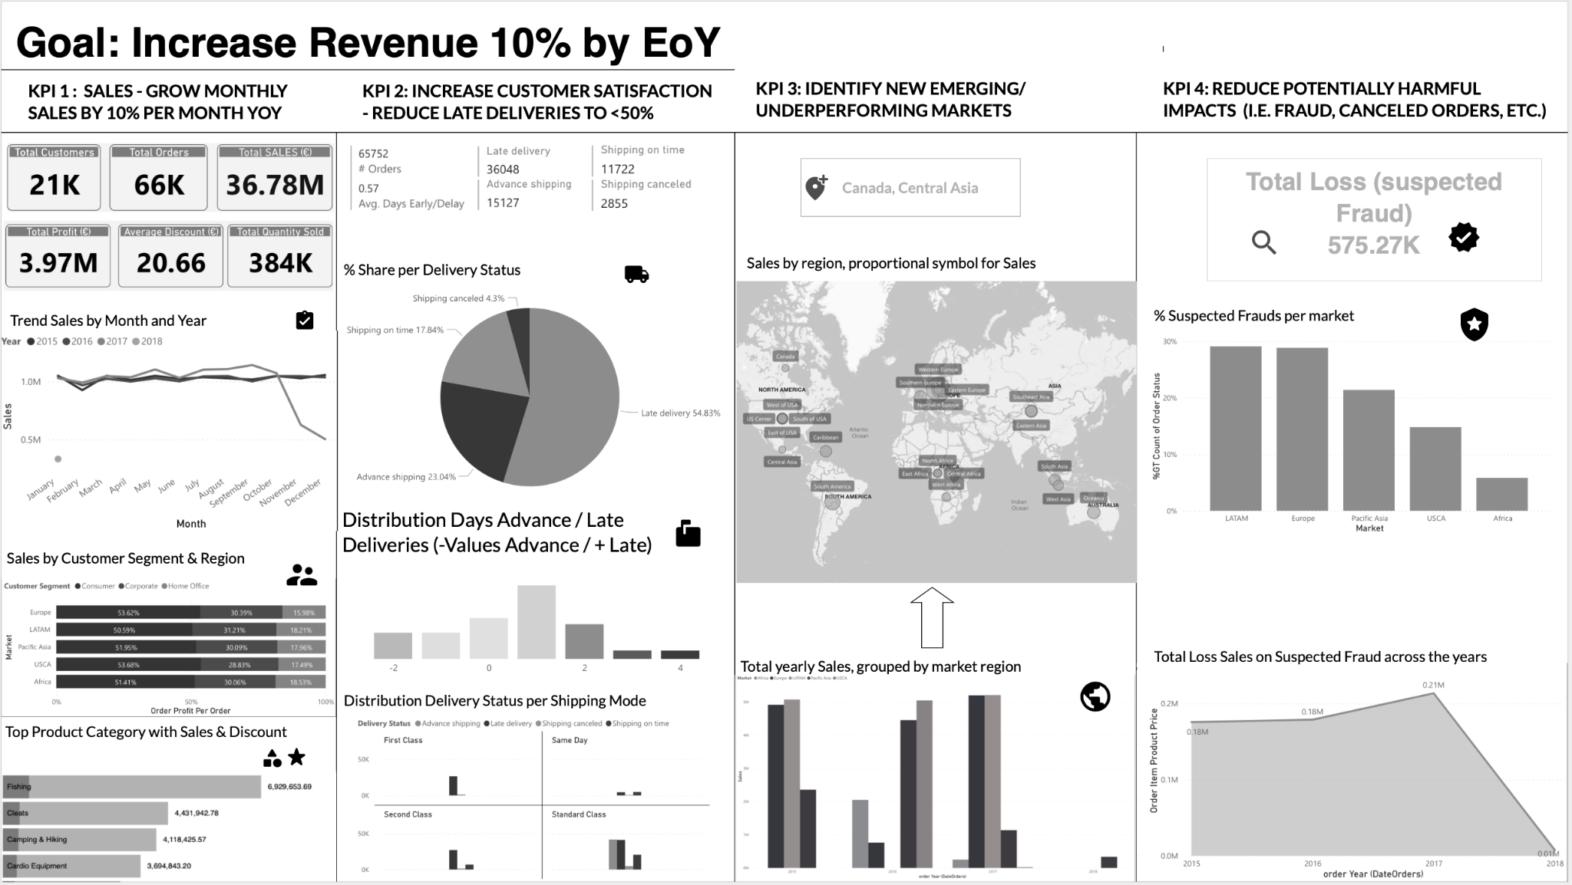
05
Dashboard Mockup

Slide 13
Thank you for your attention!

